Slide 1
Employee Time Clock Log Management
Working Demo of the ‘Work Log Management’ web application
Objective:
To maintain a time log of all the employees (this will be useful to run the payroll since the working hours of each employee is recorded)
Features:
Register an Employee of a particular department
Log working hours
Retrieve the working hours log report via Mail, Document, PDF, Image
Project Repo Location: https://github.com/vivekVells/EmployeeWorkTimeLogManagement Vivek Vellaiyappan Surulimuthu File last updated: March 25th 2018

Slide 2
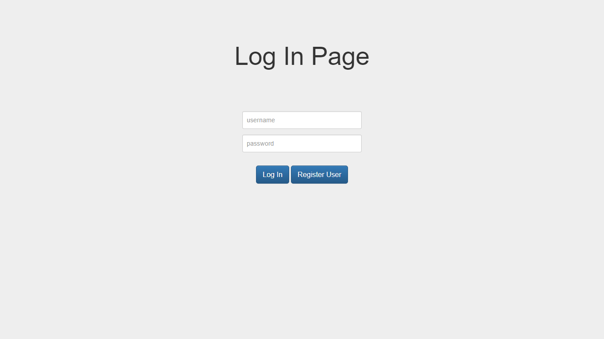
Login Page

Slide 3
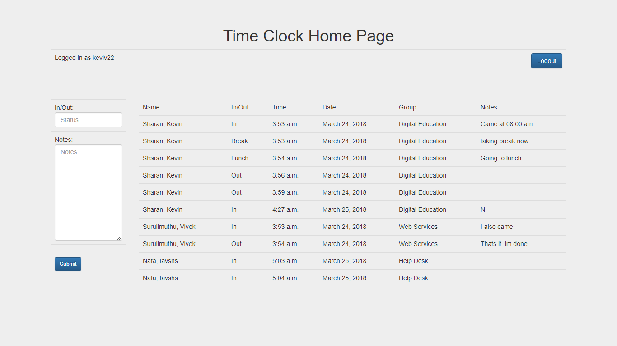
Home Page

Slide 4
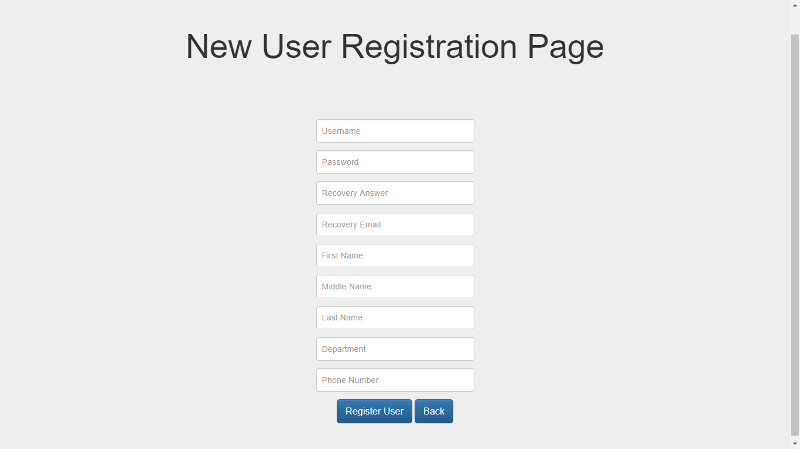
Registration Page

Slide 5
Thank you so much for viewing this working demo sheet. Hope you got an idea of how this application works. Highly appreciate the feedbacks if any.
Regards,
Vivek Vellaiyappan Surulimuthu
https://github.com/vivekVells
vivekvellaiyappans@gmail.com

